Slide 1

“Turn your kitchen a playground!”
A8: Interactive Hi-Fi Prototype
Mayowa A. Butch N. Esaw A. Tina Z.
Notes:
Revised logo :)

Slide 2
Problem/Solution Overview

Slide 3
Problem
Some people aren't willing to explore and get out of their comfort zone while cooking, not because of time/budget limitations, but simply because it is not enjoyable enough.
Notes:
Very similar from A5, just added part regarding time/budget limitations

Slide 4
Solution
A social cooking app where you can challenge your friends to cooking competitions, discover ingredients you've never tried, and actually look forward to making dinner.
Notes:
Basically unchanged since A5

Slide 5
Outline
Notes:
here by 40 s

Slide 6
Outline
Heuristic Evaluation Results
  Summary of Results
  Addressing Changes
UI & Product Revisions
Prototype Implementation Status Update
  What's There
  Future Steps
Demo Video
Notes:
quick overview

Slide 7
Heuristic Evaluation Results
Notes:
here by 40 s

Slide 8
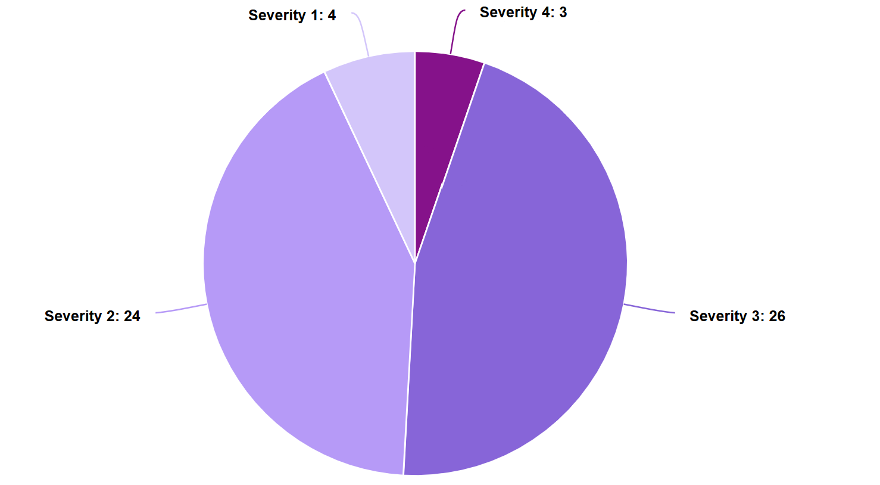
Heuristic Evaluation Results
Notes:
Here by 7:00

Slide 9
Heuristic Evaluation Results
1: x4
4: x3
Severity 2:
x 24
Severity 3:
x 24
Notes:
Here by 7:00

Slide 10
Heuristic Evaluation Results
Only 3 Severity 4 violations!
26 Severity 3 Violations
  Total of 29 High-Severity Violations
Most Severity 2 violations were the same categories as Severity 3/4s
  Mostly same concepts/resolutions as higher-severity violations, but in less impactful app areas.
Largest Offending Categories:
  H1: Visibility of System Status (7 violations)
  H2: Match b/w System & World (7 violations)
  H3: User Control & Freedom (5 violations)
  H4: Consistency & Standards (6 violations)
  H5: Error Prevention (8 violations)
  H6: Recognition not Recall (5 violations)

Slide 11
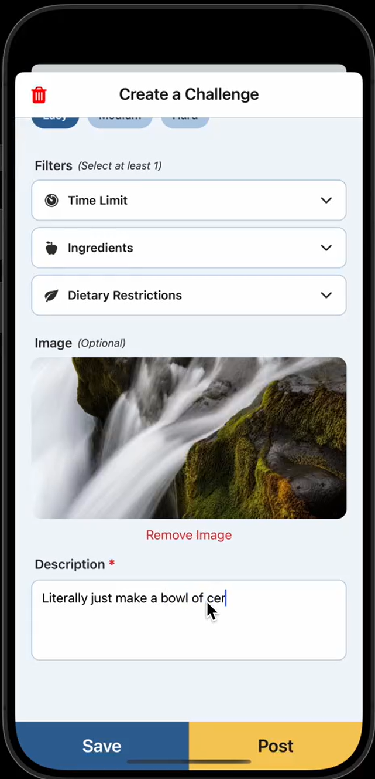
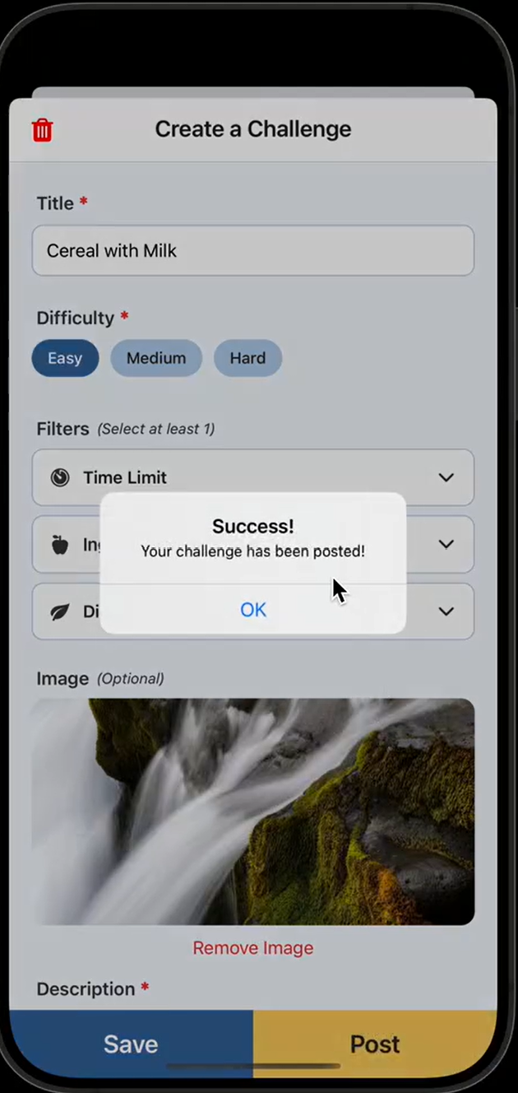
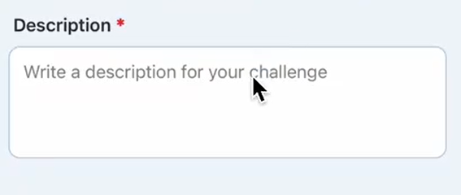
Heuristic Evaluation Results
H1: Visibility of System Status
  No save progression or success indicators in various locations
    Added save/resume functionality
  Many unclear medium-fi prototype flows
    Removed presumptive flows that prevented users
from selecting certain buttons/options that
existed for med-fi Figma simplicity.
  (All Lower-severity issues fixed from above)

Slide 12
Heuristic Evaluation Results
H2: Match b/w System & World
  Many terms aren't clear without prior knowledge
    Will address via onboarding
    Includes lower-severity H2 violations
  Some terms generally confusable (i.e. time limit vs. time to cook)
    Clarified "time limit" as a filterable tag; time to cook can go in description. Will also be onboarded
  Added challenges are at bottom, requiring scrolling
    They now appear at top!

Slide 13
Heuristic Evaluation Results
H3: User Control & Freedom (2 Severity 4s!)
  Users cannot save progress when creating challenge
    Added save progression!
  After creating a challenge, "+" icon does not reappear
    Med-Fi Figma Issue; "+" icon now persists!
  After certain actions, redirects to different pages
    No longer does this
  No visible click indicators for certain popups
    Med-fi issue; will be fixed in hi-fi
(popups not yet implemented)

Slide 14
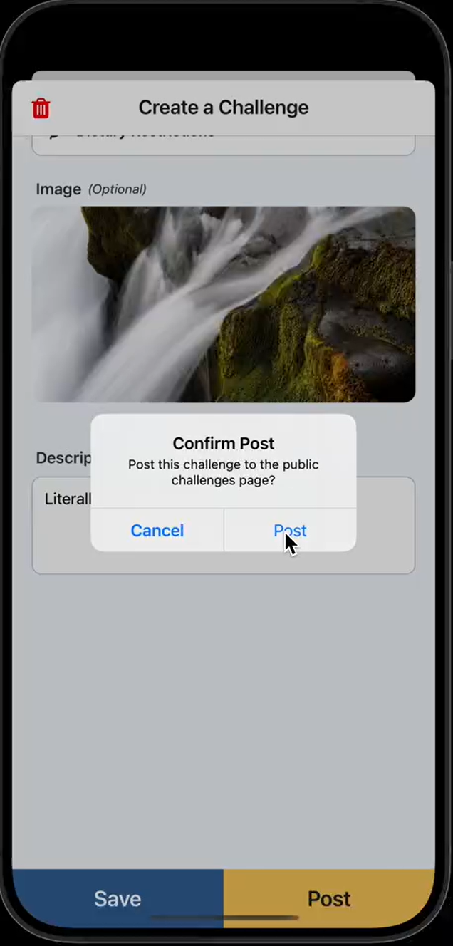
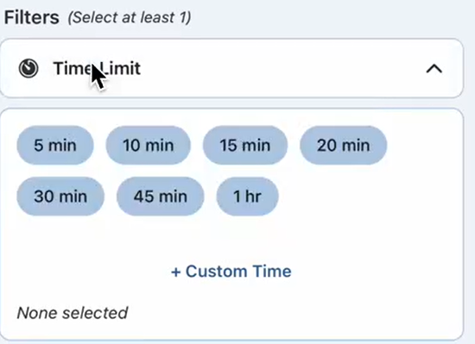
Heuristic Evaluation Results
H4: Consistency & Standards
  Most of these were medium-fidelity prototype issues with:
    visual design (colors)
    spacing
    rerouting after certain actions (addressed in H3)
  Finer comb has been used for high-fidelity prototype
    No longer "drag/drop" for unknown issues in Figma
H5: Error Prevention
  Lacks descriptive error messages and action confirmation
    Action confirmations added
    Error message descriptions will be added.
  Lacking input restriction/guidance
    Dropdowns for many inputs (i.e. filter tags) added

Slide 15
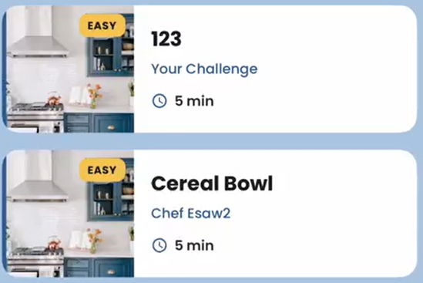
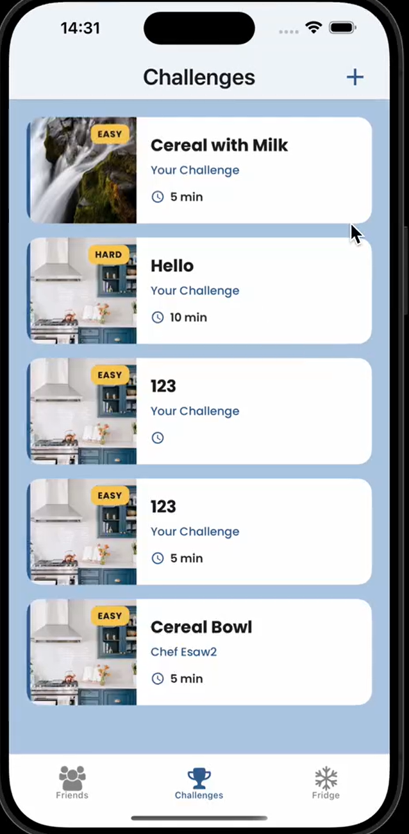
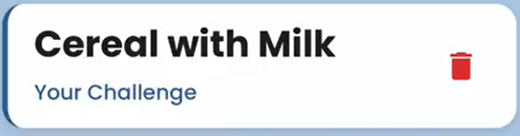
Heuristic Evaluation Results
H6: Recognition not Recall
  Lacking indications of personally-created content vs. prior content
    Added "Your Challenge" Indicators to challenges you create
(after clicking on challenge)
  Lacking specific terminology on friends tab
    Will clarify
Notes:
"After sharing a challenge with a friend, there is no new indication on the ""friends list"" telling you that you've already shared that challenge with a particular friend.

Slide 16
Heuristic Evaluation Results - Outstanding 3/4s
H11: Accessible Design
  (4): BG Images too much contrast + space
    Removed overlays/text directly over any BG images
  (3) Colors of BG match that of some elements too closely
    Added more contrast and critical lens for such occurrences
H12: Value Alignment
  (3) Various obscurities
    Resolved through filter tags or onboarding

Slide 17
Heuristic Evaluation Results
Takeaways
  Many violations were due to lack of particular design thinking for that difficulty and/or unclear indication of what was abstracted for med-fi prototype functionality
Going Forward
  More care for indicators, onboarding, user control, visual design, were added to our vision for the final product.

Slide 18
(Review) Design Values + Usability Goals

Slide 19
Let ‘Em Cook! aspires to be…
For Experimenting,
For Everybody,
For Sharing, and
For Fun.
Notes:
Our 4 values

Slide 20
Usability Goals (as a reminder)
Goal 1: Efficiency/Speed
Time Taken to Achieve Task
measured in seconds
Dictates simplicity and relative connection of UI
Goal 2: Clarity/Confusion
Number of "incorrect moves" towards accomplishing task
measured in taps
Dictates confusing elements, balances goal 1 for speedier individuals
Notes:
Here by 7:00

Slide 21
Hi-Fi UI Changes

Slide 22
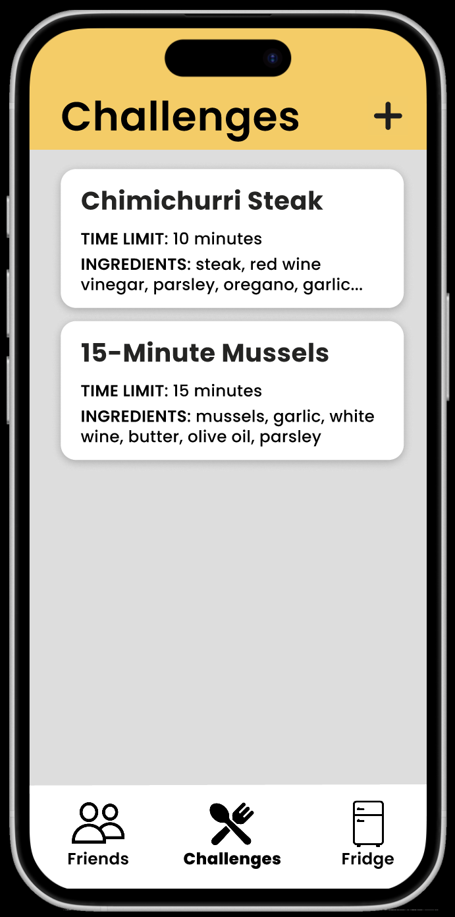
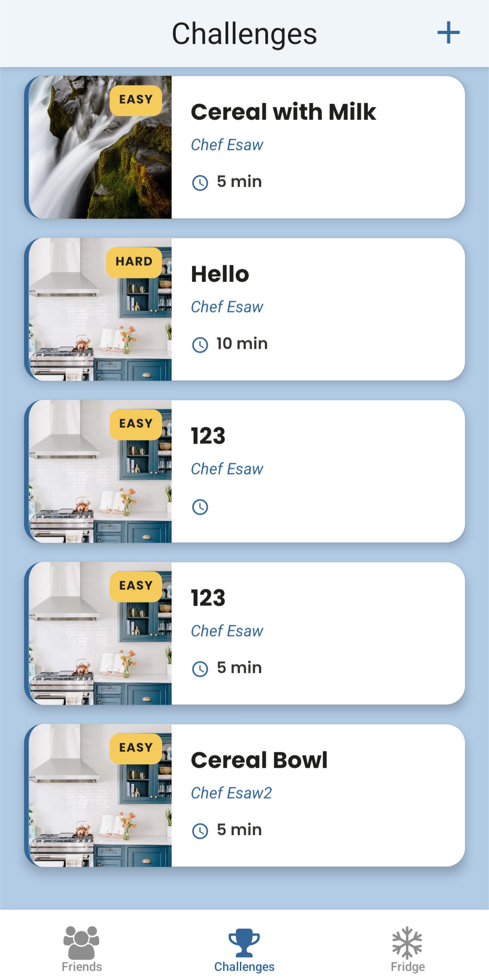
Hi-Fi UI Changes (So-Far)
Landing/ Challenges Page
  More consistent color scheme, centering, and spacing of text
  Visible tags for difficulty displayed (yellow, to stand out against blue)
  Detail of creator visible for recognition over recall
  Time limit visible (if listed) for self-selection simplicity
Values: Those can choose time they're comfortable with to experiment while still having fun
  Non-timed challenges for Everybody
OLD
NEW
Notes:
Here by 7:00

Slide 23
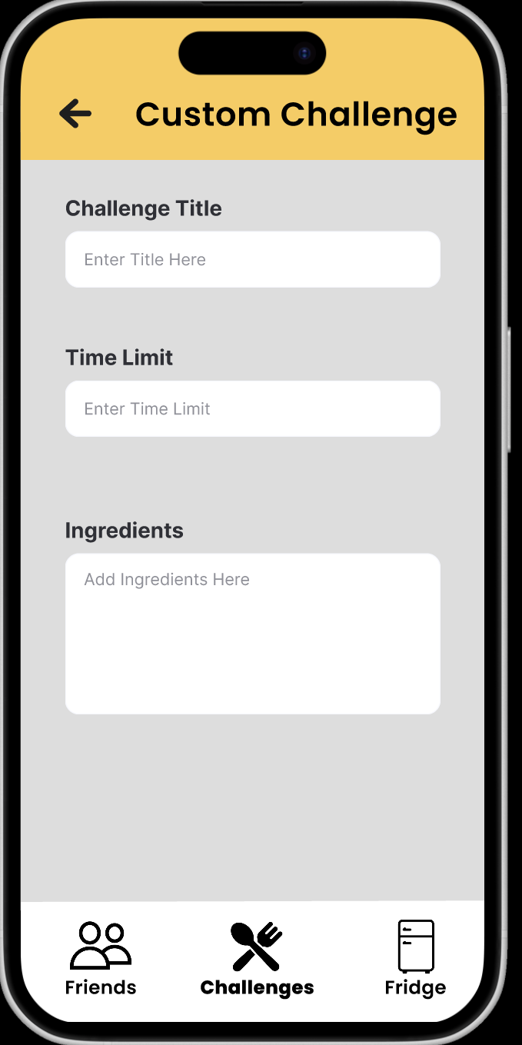
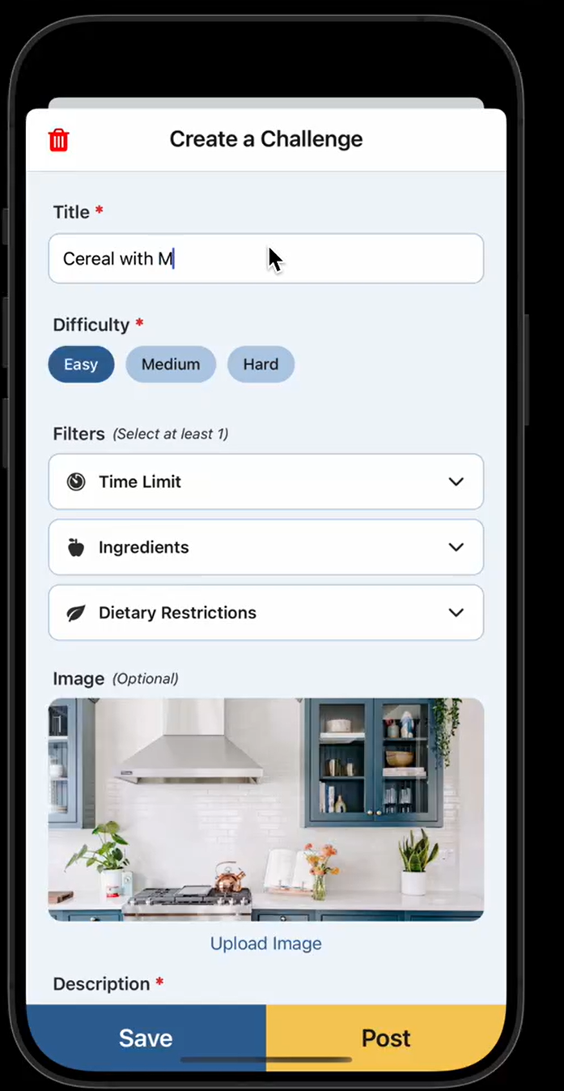
Hi-Fi UI Changes (So-Far)
OLD
NEW
Custom Challenge Page
  Changed topbar to be "popup" with trash icon to clearly communicate deletion
  Added Save/Post buttons to clearly provide actions aligned with user intent
  Added Tags (Difficulty, filterables) to alleviate typing and formatting effort
  Added image upload section (med-fi abstracted)
Values
  Dropdown options facilitate sharing
  Everybody can create a custom challenge that suits them
Goals
  Dropdowns include speed of actions
  Descriptions and preset options improves clarity of actions
Notes:
Here by 7:00

Slide 24
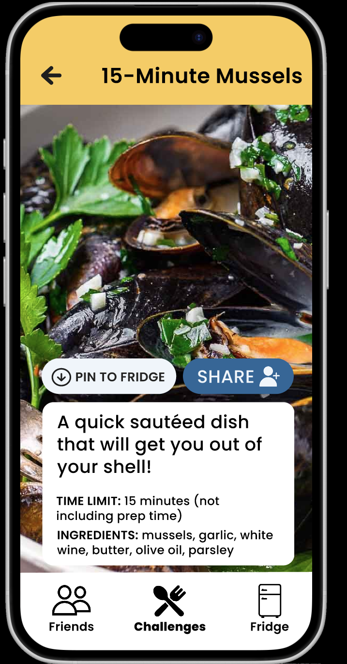
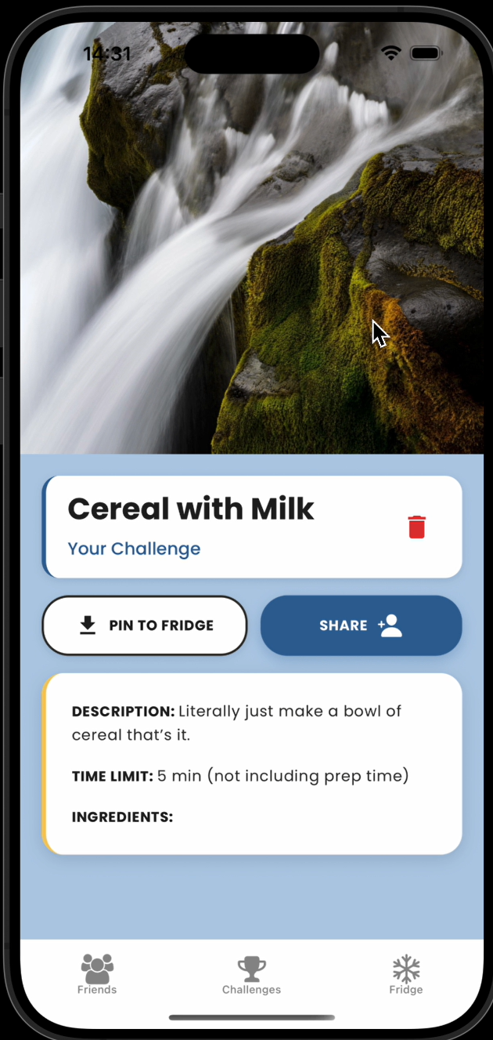
Hi-Fi UI Changes (So-Far)
OLD
NEW
Created (Individual) Challenge Page
  Image has clear demarcation before text appears
  Distinction of challenge creator (your challenge) included for clarity of usage.
  Challenge deletion button → trash bin icon for recognition over recall
  Font, spacing, centering simplified and cleaned.
Notes:
Here by 7:00

Slide 25
Prototype
Implementation

Slide 26



Hi-Fi Prototype Implementation
Framework/Tools
Notes:
Using react native for the app itself, to make cross-mobile app development easy and quick (as well as the fact that we dont plan to have any native functionality so it would be a repetitive act to do for both ios and android)

Slide 27
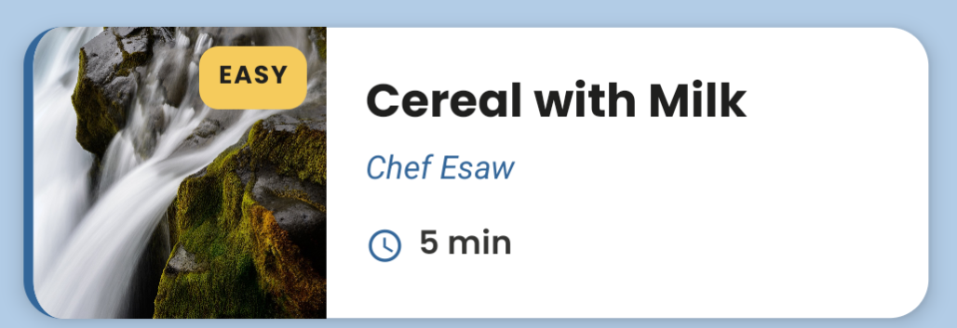
Hi-Fi Prototype Implementation
AI Usage
  AI was used to form element layout after visual guidance instructions provided. Colors, spacing, font choice, etc. were supplied to AI, and AI helped create the physical elements to reduce manual coding of repeated static elements.
Notes:
Can make framework/tools visual I guess.

Slide 28
Hi-Fi Prototype Implementation
Features Implemented:
  Webpage Skeleton, including bottom bar tab links (to empty pages)
  SupaBase database setup
  Main Challenge Page
    Scrollable List of challenges w/ time limit, creator, and difficulty level clearly visible
  Complex Task (Create a Custom Challenge)
    Includes functional calls to SupaBase
    Difficulty Selection
    Option to choose filters such as Time Limit, Ingredients, and Dietary Restrictions
    Ability to save a challenge and come back to it or post to database
Notes:
Here by 7:00

Slide 29
Hi-Fi Prototype Implementation
Core Features To Be Implemented (Done by Mid-Thanksgiving Break)
  Fridge Tab: Includes pinned challenges and log of completed challenges
    Simple Task (Pin a Challenge to Fridge)
    Personalized pet pal customization
  Friends Tab: Includes ability to send friends a challenge and see their personalized pet pal.
    Moderate Task (Send a Specific Challenge to a Specific Friend)
Additional Features To Be Implemented (Done By Early Week 10)
  Onboarding w/ explanations of each tab and core buttons
  Challenge Tag Filter/Search
  Completed Challenge Submission
  Personalized Pet Pal Accessory Unlocking
Mid/Late Week 10 Reserved In Case Of Implementation Emergency
Notes:
Here by 7:00

Slide 30
Hi-Fi Prototype Implementation
Wizard of Oz Techniques
  Images included in camera roll are predetermined + already on the app.
  (future Implementation) Friends are predetermined, friends will automatically accept a challenge.
    Necessary b/c social app Cold Start Problem is difficult to address (especially during testing)
  (Future) Reward for challenge → predetermined outfit, not random. This is so design effort can be spent on app functionality over art design.
Hardcoded Techniques - None at the moment!
Notes:
Here by 7:00

Slide 31
Hi-Fi Prototype Implementation
Plan For Completion (Mirrors methodology thus far)
  Developers (Mayowa, Esaw, Tina) rotate on high-priority implementations with their dependent free time.
  Update the team with needs/current statuses
  Discuss any large issues/possible reconsiderations
  Designer (Butch) verified compliance with heuristics, goals, values, feedback, etc.
  Designer makes steady progress on final report, poster, and pitch in parallel to team updates
Notes:
Here by 7:00

Slide 32
Demo

Slide 33
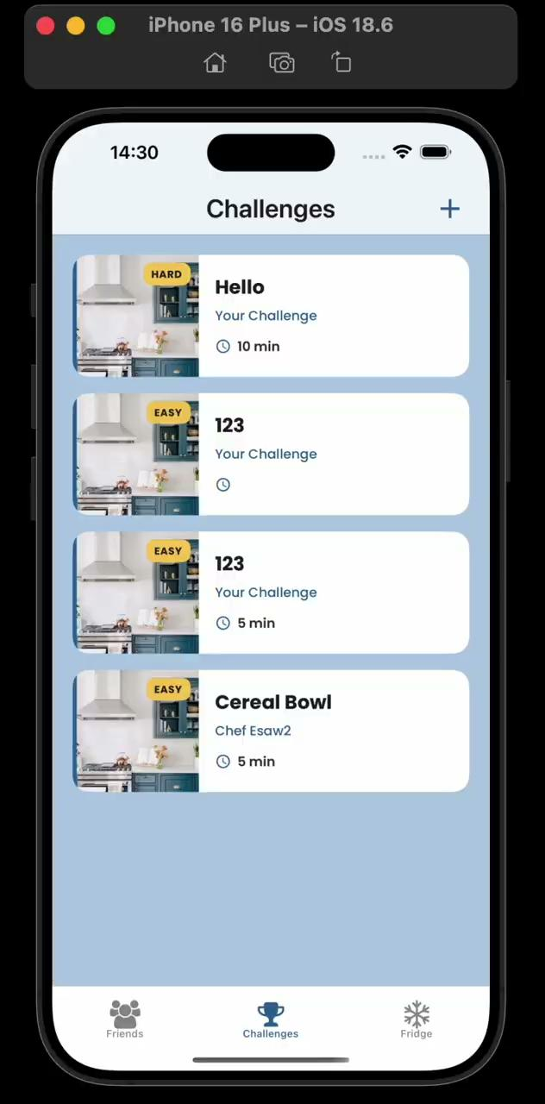
Demo Video

Slide 34
Appendix

Slide 35
